Slide 1
Analysis of phase transitions in the Gray-Scott model
By Coen Honingh (10988459), Lennart Mettrop (10432973),
Tristen Assenmacher (12168599), Toby van Gastelen (11260572)
Group 7

Slide 2

Contents
Introduction:
Gray-Scott model
Phase transitions
Goal: early-warning
Method:
Image processing
Order parameters
Results + Analysis
Conclusion

Slide 3
Introduction

Slide 4
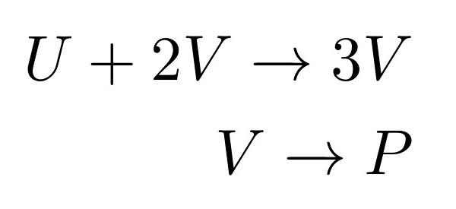
Gray-Scott model
Reaction diffusion system
Tracking U and V in time
and space
U V

Slide 5
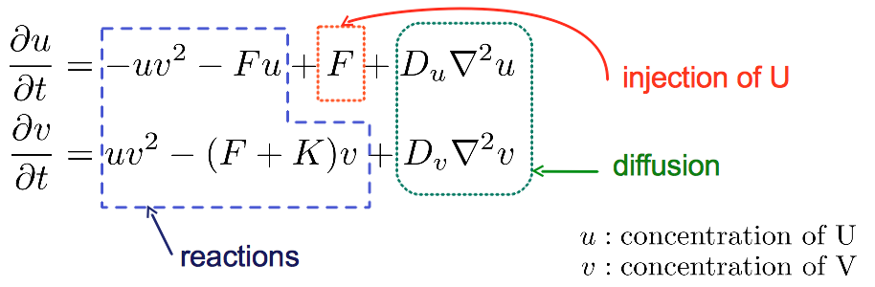
Reaction diffusion systems
System of PDEs
Parameters: f, k

Slide 6
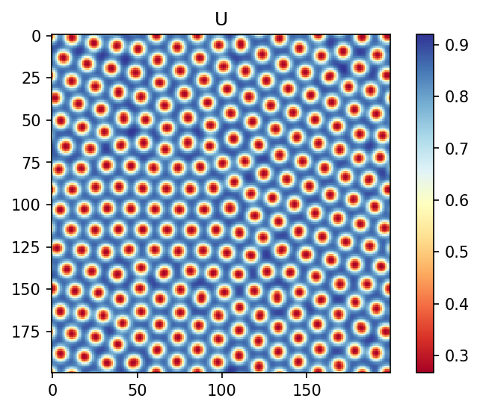
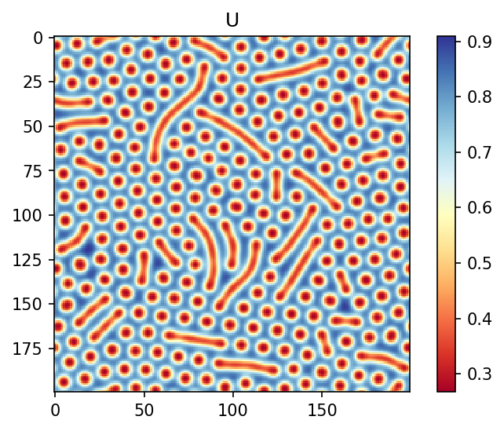
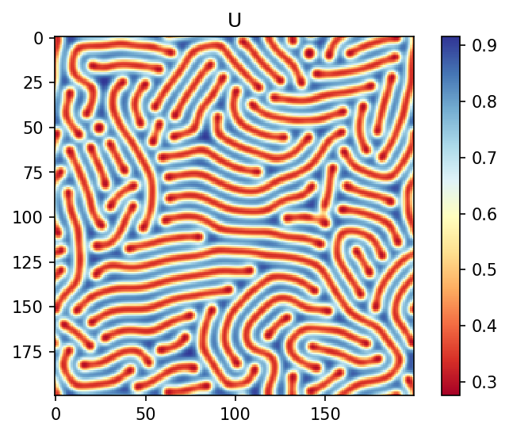

Different patterns
Parameters: f, k
Determine behaviour of system

Slide 7
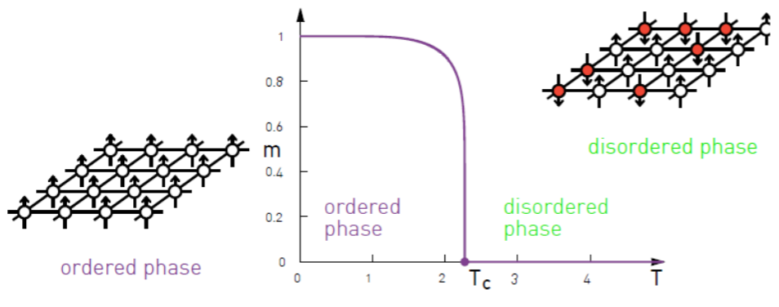
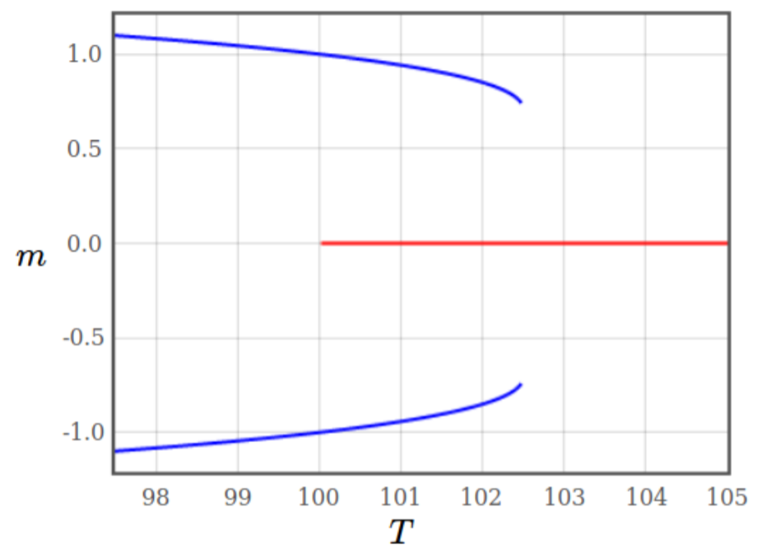
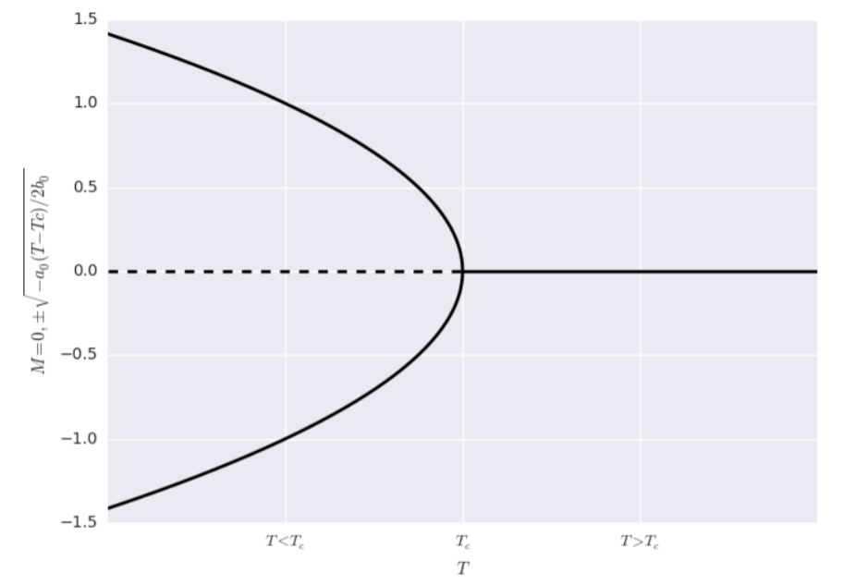
Phase transition: Ising model
Control parameter:
Temperature (T)
Order parameter:
Magnetization (M)
mixed phase
No mixed phase

Slide 8

Phase transition: Early-warning
Parameter that changes before phase transition
We consider Fisher information
for this purpose

Slide 9
Method

Slide 10
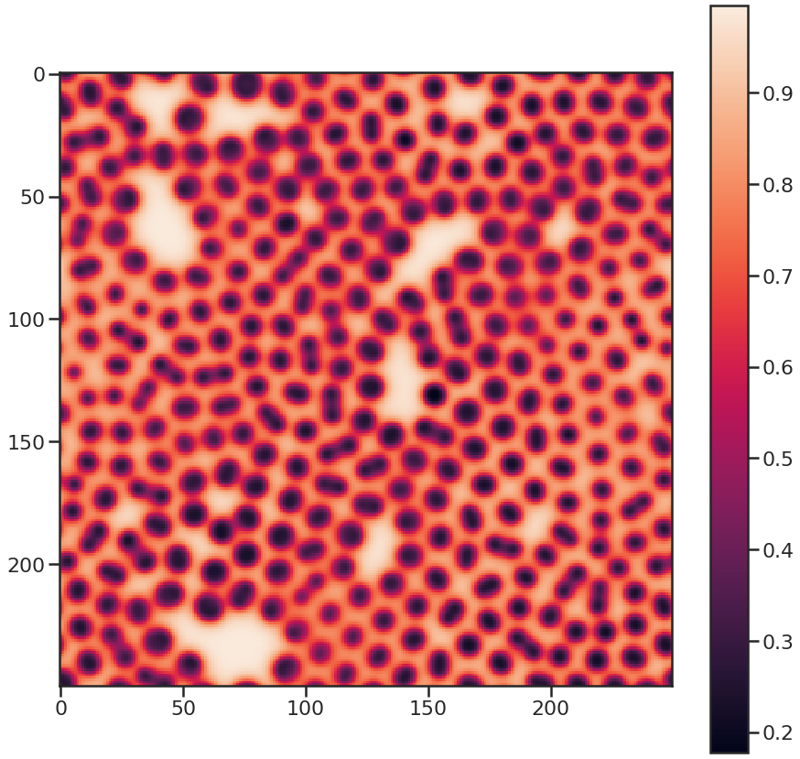
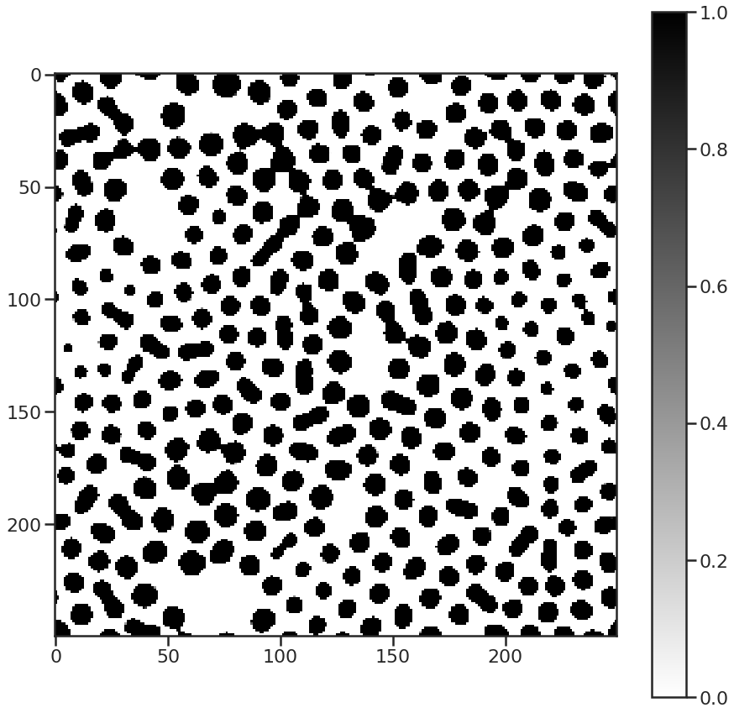
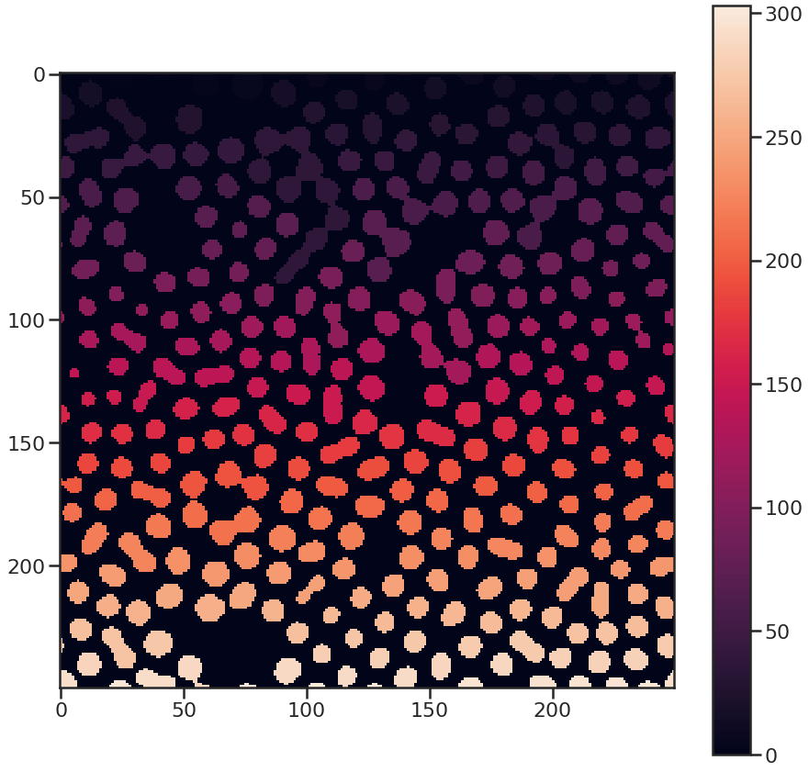
Image processing
Convert image to greyscale and binarize (blur + threshold)
Count and label connected components

Slide 11

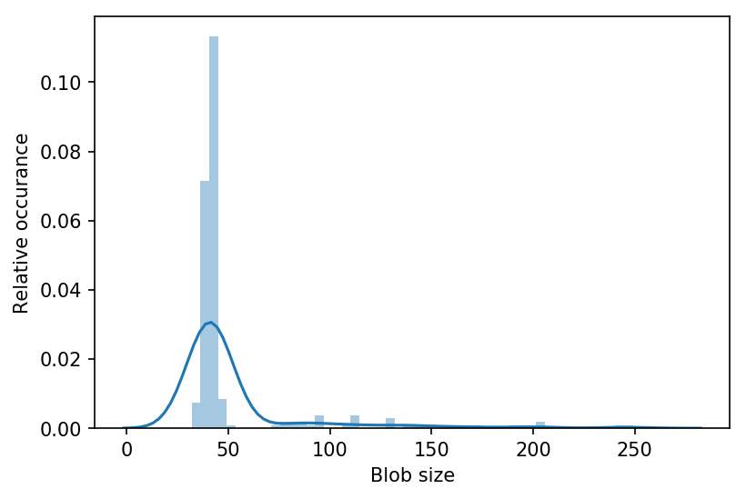
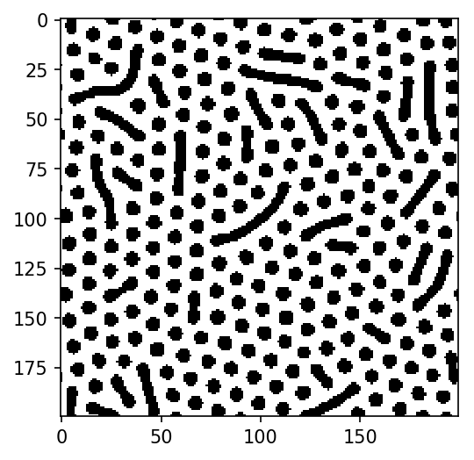
Order parameters: blobs
Continuous black strips (blobs)
Fit pdf to blob size distribution using Gaussian KDE
p(x|θ)
θ = (f,k)

Slide 12
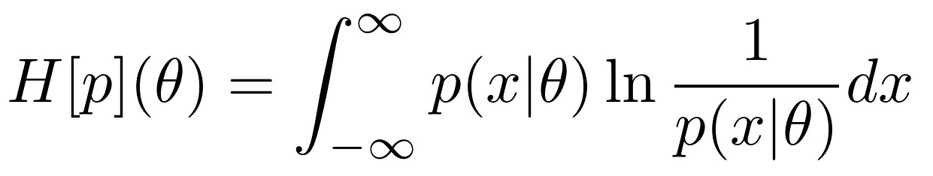
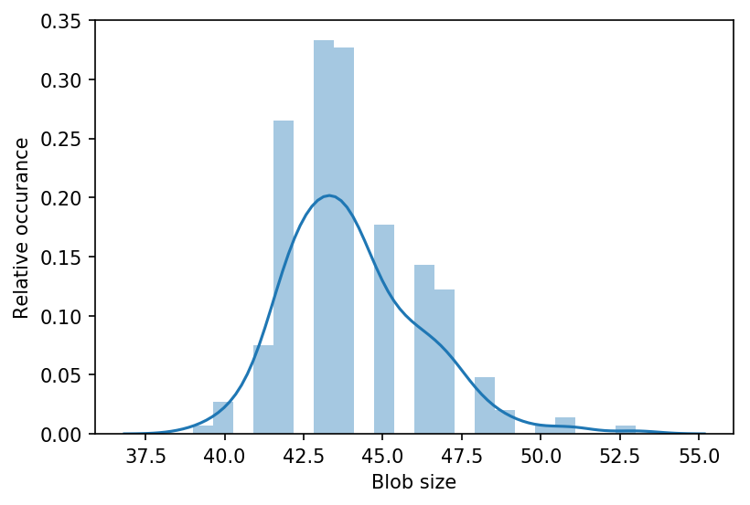
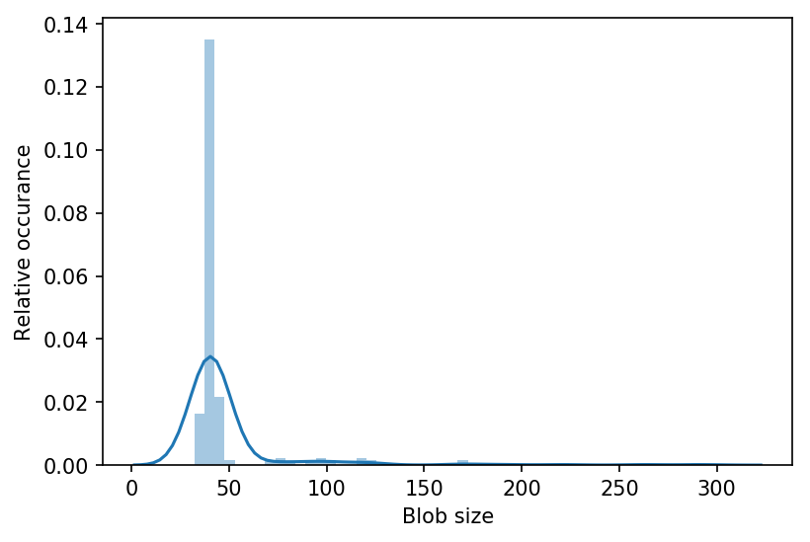
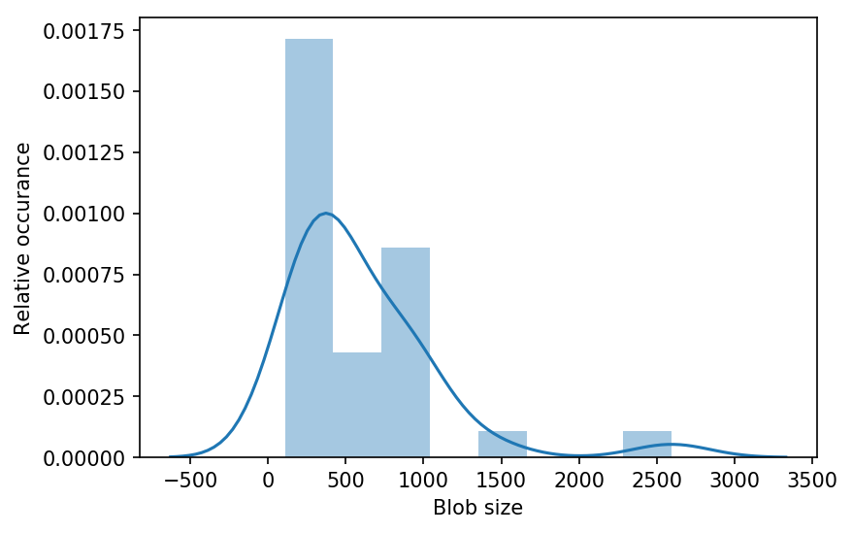
Order parameters: Shannon entropy
Use p(x|θ) to calculate Shannon entropy
Traditional order parameter
Shannon entropy
Low
Middle
High

Slide 13

Order parameters: Fisher information
Fisher information: measure of change in distribution
Not a traditional order parameter
Used for early-warning

Slide 14
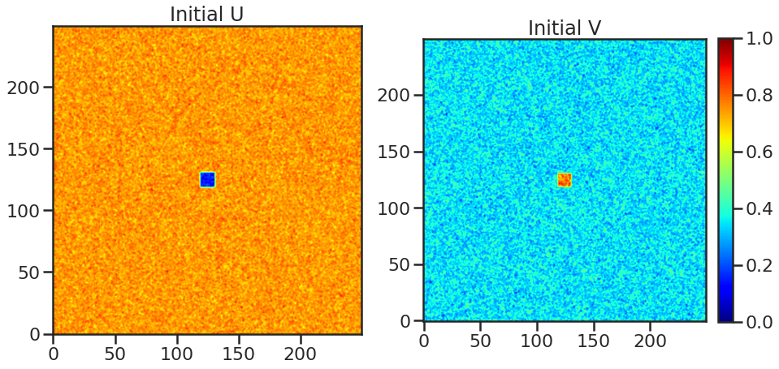
Initial conditions
250 x 250 discrete grid
U = 1, V = 0
25 x 25 square: U = 0.5, V = 0.25
Added Gaussian noise μ = 0,05
D_{u} = 0.16 D_{v} = 0.08
0.04 < k < 0.07
0.00 < F < 0.06

Slide 15
Computational method
Forward-Time Central-Space (FTCS) numerical integration scheme
dx = dy = dt = 1.0
20 000 time steps
PDF estimation: scipy.stats.gaussian_kde
Entropy & Fisher information: scipy.integrate.quad

Slide 16
Results

Slide 17
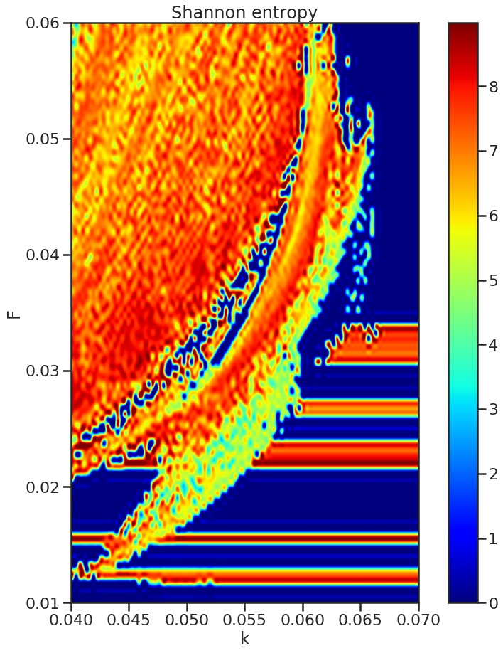
Model phase map: entropy
High entropy -> large uncertainty in blob size
Low entropy -> near identical blob sizes
Fails to capture transitions when blob size distribution is constant

Slide 18
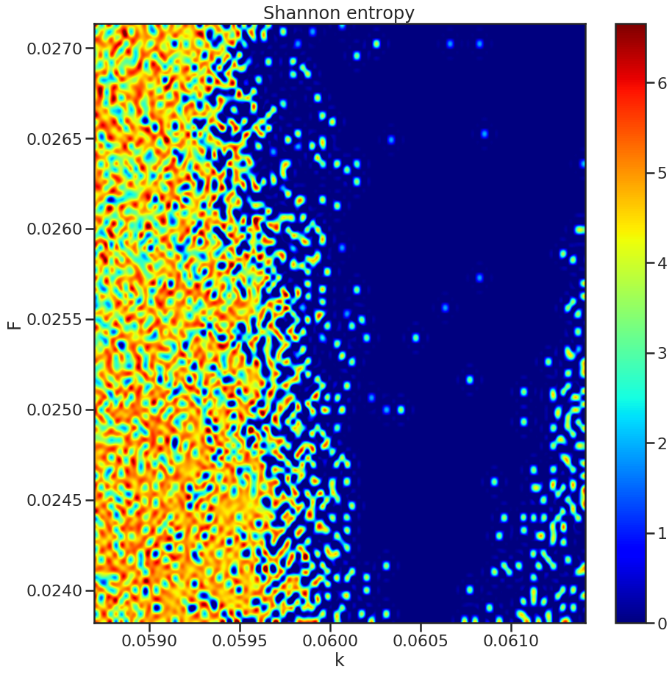
Transition 1
From (k=0.0614, F=0.0271) top right
To (k=0.0586, F=0.0238) bottom left
Path from stable to chaotic spots

Slide 19
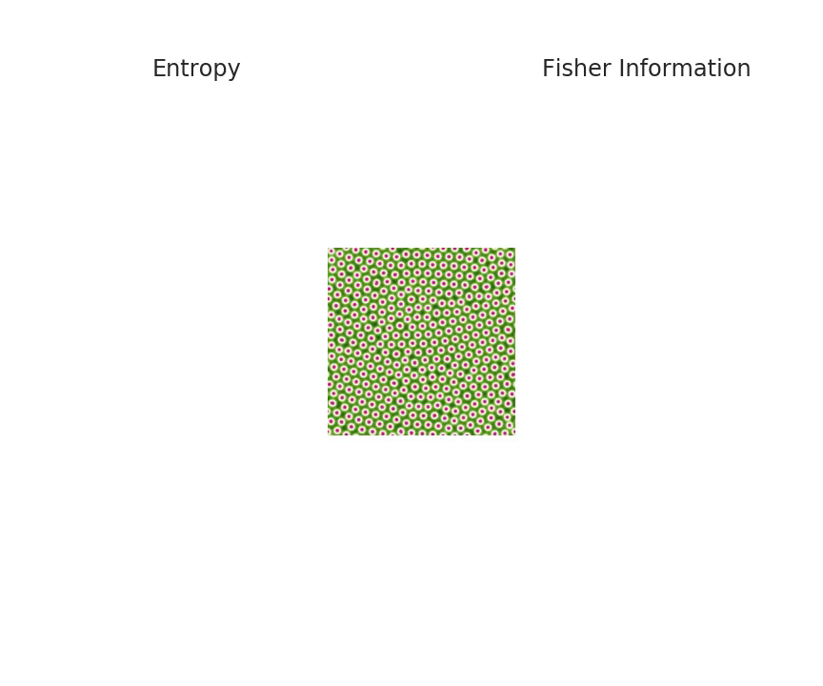

Slide 20
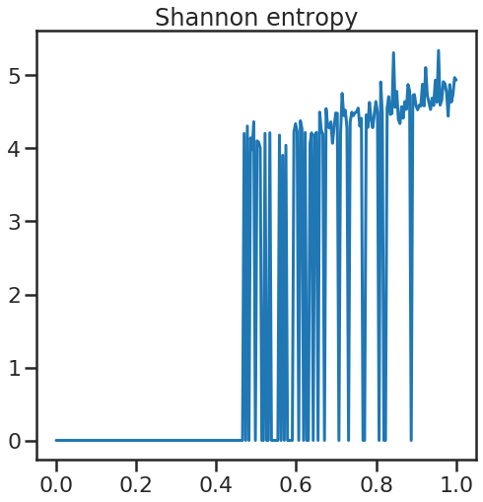
Distribution while changing parameters

Slide 21
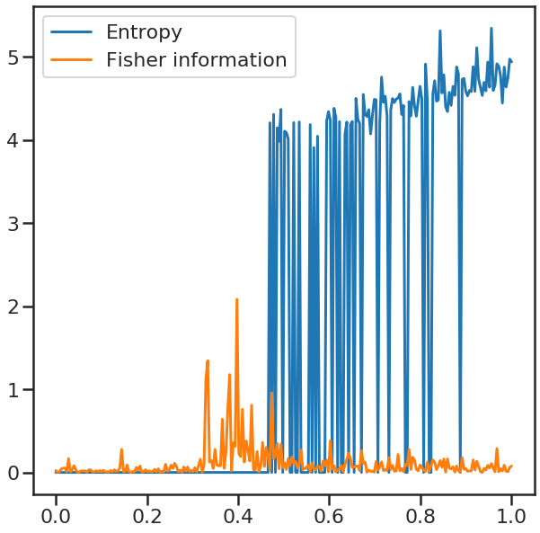
The Fisher Information
Captures a broader range of changes to the system
Early warning for transition to spatio-temporal chaos

Slide 22
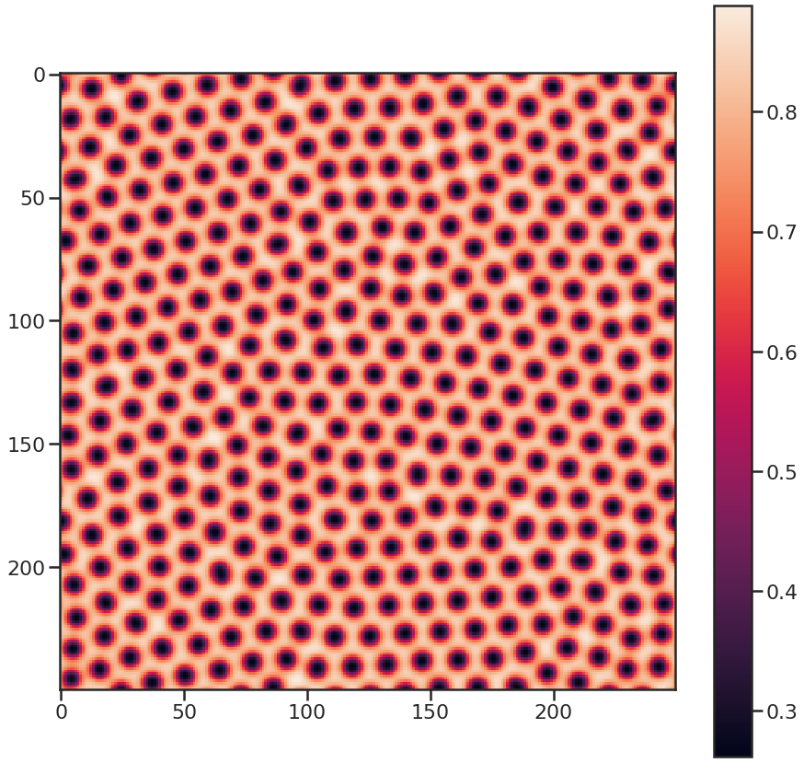
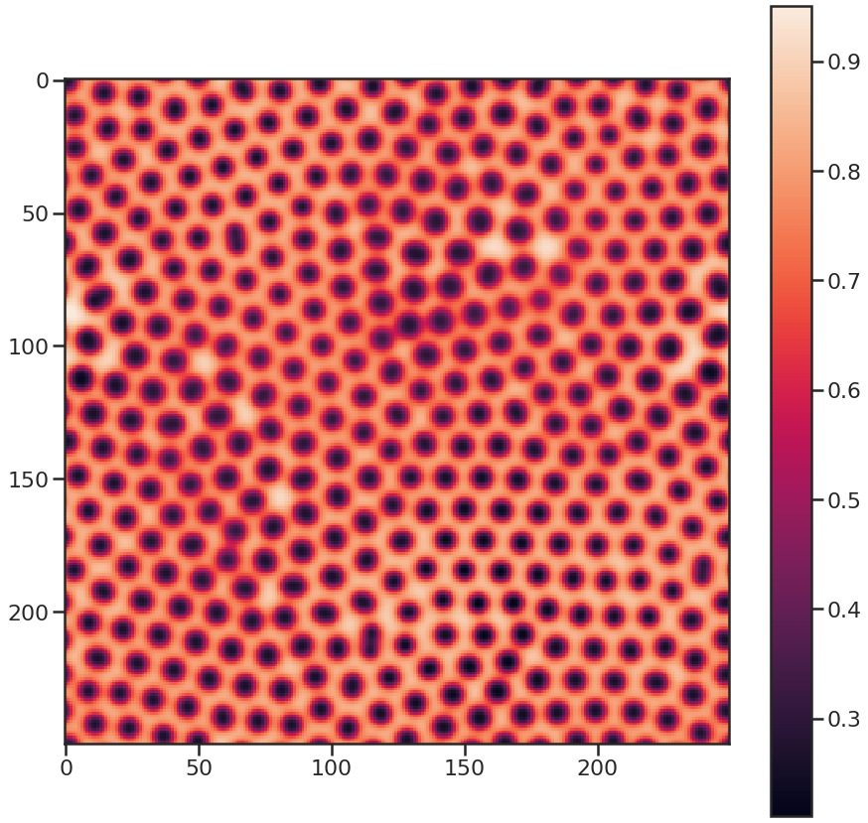
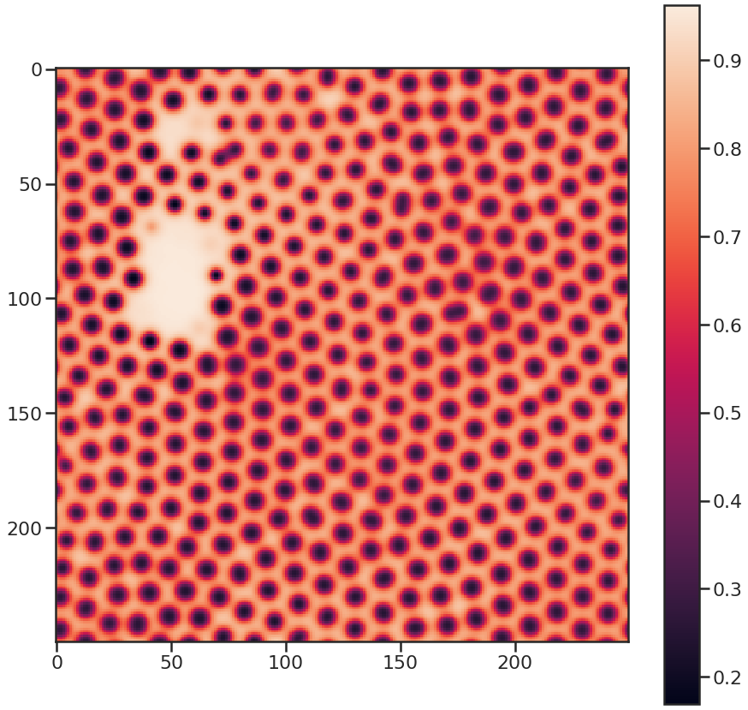
Entropy vs. Fisher information
Self-replicating spots
Entropy: low
F.I. : low
Gap formation
Entropy: low
F.I. : high
Blob fusing
Entropy: high
F.I. : middle

Slide 23
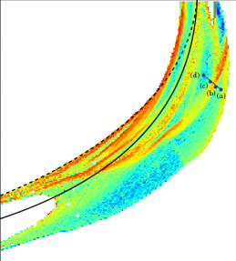
Transition 2
From (k=0.0652, F=0.0395) middle right
To (k=0.0632, F=0.0428) top middle
Path from stable spots to variable worms
Omri Har-Shemesh, Rick Quax, Alfons G Hoekstra, and Peter Sloot. Information geometric analysis of phase transitions in complex patters: the case of the Gray-Scott reaction-diffusion model. (2016)

Slide 24
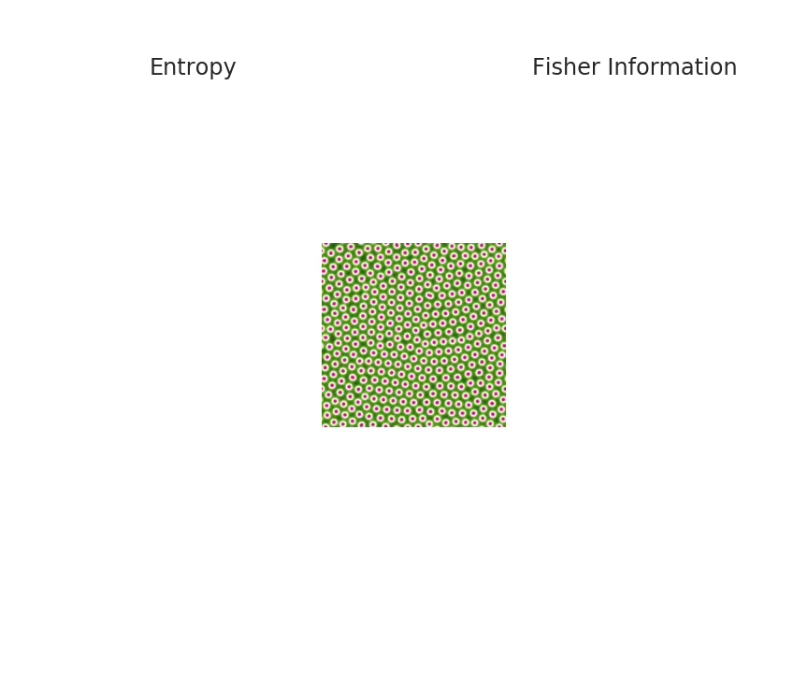

Slide 25
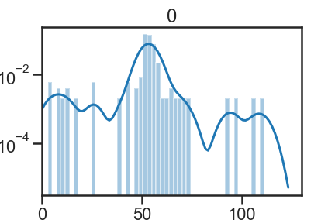
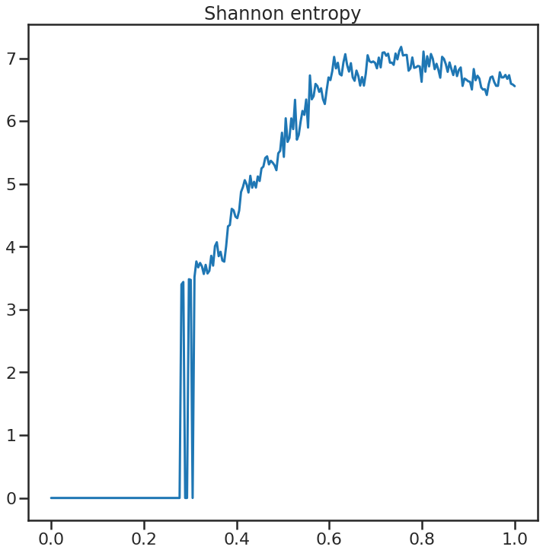
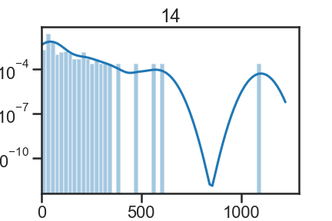
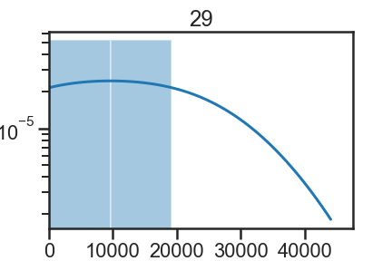
Distribution while changing parameters

Slide 26
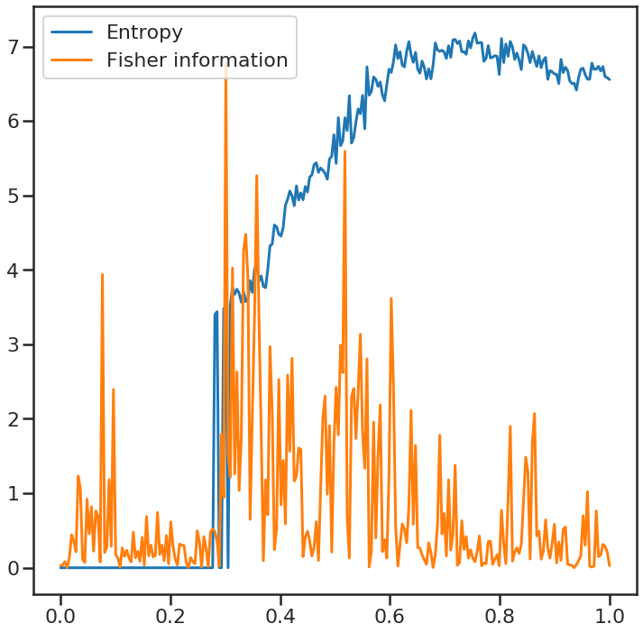
Entropy vs. Fisher information
F.I. does not improve upon entropy
Unreliable early warning: high amount of noise

Slide 27
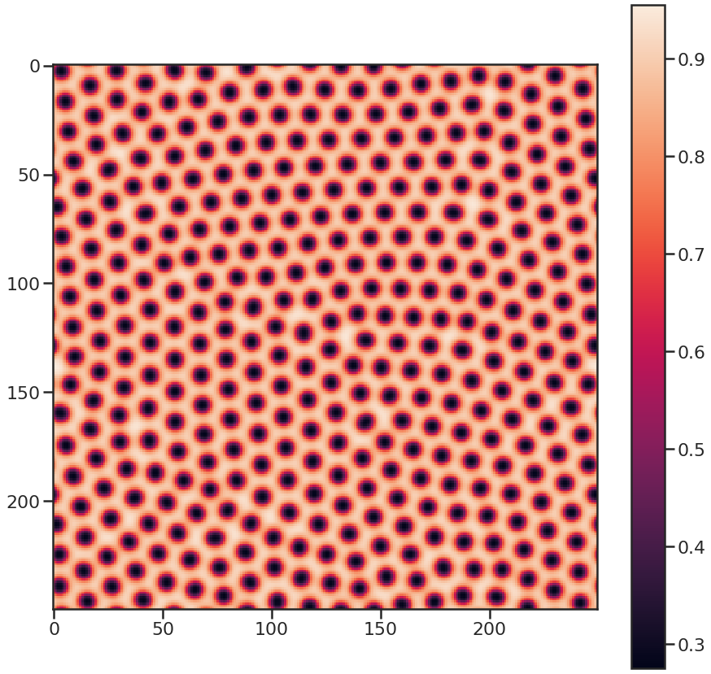
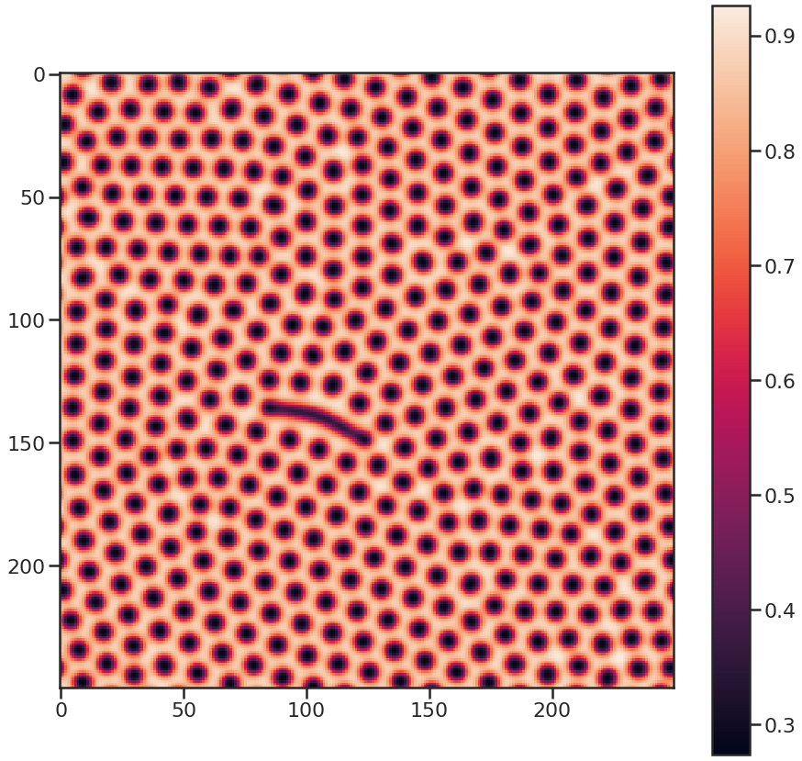
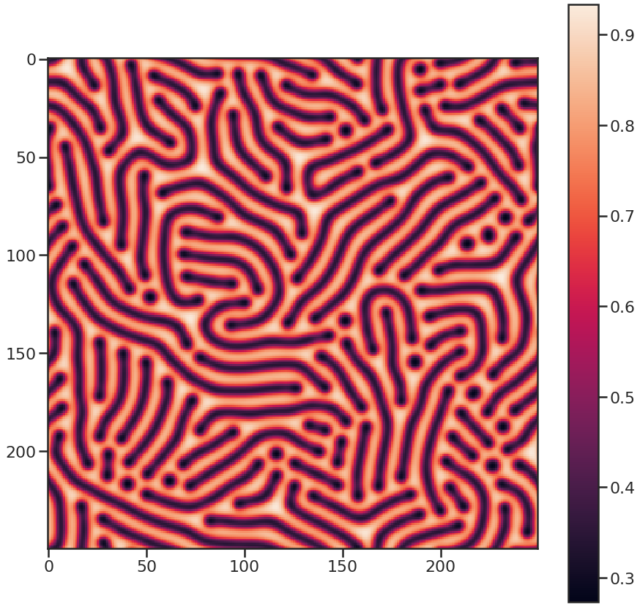
F.I. and Entropy
Self-replicating spots
Entropy: low
F.I. : low
Spots to worms
Entropy: medium
F.I. : high
Maze-like worms
Entropy: high
F.I. : medium

Slide 28
Conclusion
Entropy does not inherently describe phase transitions.
Fisher information describes the relative entropy change over a trajectory.
It maximizes at phase transitions and does not provide early warnings but instead an extremely robust transition indicator.

Slide 29


Slide 30
References
Slides Complex Systems Simulation course (dr. R. Quax). University of Amsterdam (2019)
Lidia Yamamoto. PyCellChemistry: The Gray-Scott Example. Last accessed 24 June 2019
Holzmann CFD. (2016, June 28) Holzmann CFD & OpenFOAM – Gray Scott Model (Pattern 1) [Video File]. Retrieved from https://www.youtube.com/watch?v=XG3uwAEpWjI
Omri Har-Shemesh, Rick Quax, Alfons G Hoekstra, and Peter Sloot. Information geometric analysis of phase transitions in complex patters: the case of the Gray-Scott reaction-diffusion model. (2016)

